Slide 1
Random Variable
Chapter # 4

Slide 2
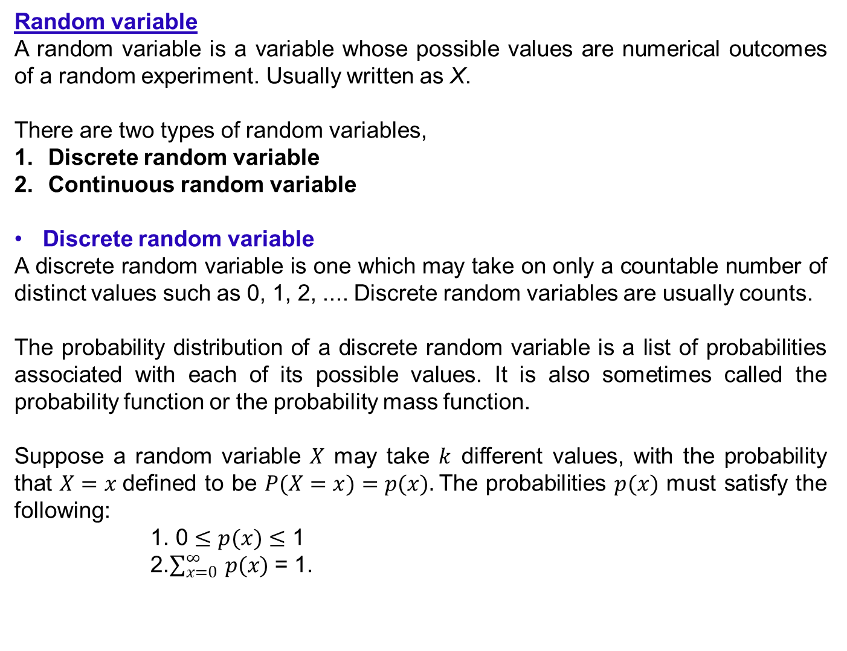
Random variable
A random variable is a variable whose possible values are numerical outcomes of a random experiment. Usually written as X.
There are two types of random variables,
Discrete random variable
Continuous random variable
Discrete random variable
A discrete random variable is one which may take on only a countable number of distinct values such as 0, 1, 2, .... Discrete random variables are usually counts.
The probability distribution of a discrete random variable is a list of probabilities associated with each of its possible values. It is also sometimes called the probability function or the probability mass function.
Suppose a random variable $X$ may take $k$ different values, with the probability that $X=x$defined to be $P(X=x)=p(x).$The probabilities $p(x)$ must satisfy the following:
1. 0 $≤$ $p(x)$ $≤$ 1
2.$\sum_{x=0}^{∞}{ p(x)}$ = 1.

Slide 3
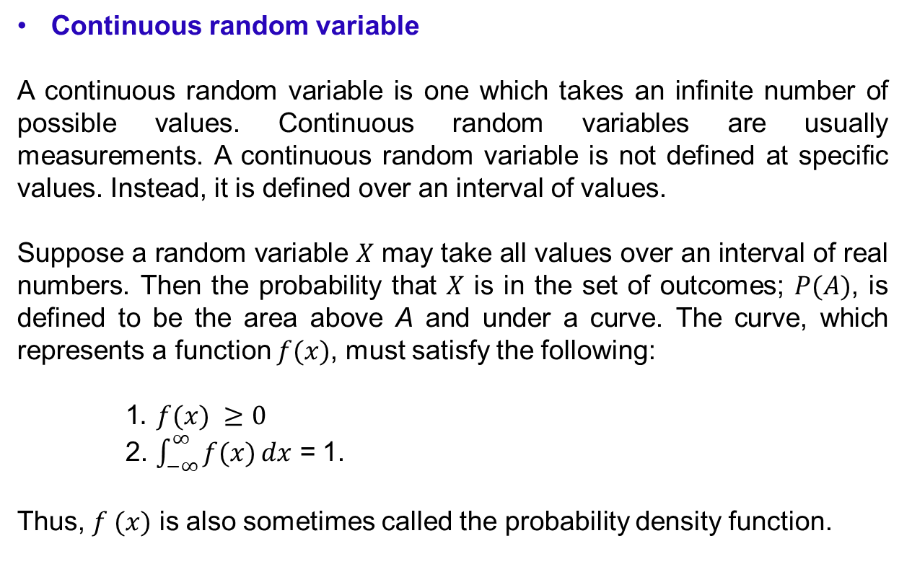
Continuous random variable
A continuous random variable is one which takes an infinite number of possible values. Continuous random variables are usually measurements. A continuous random variable is not defined at specific values. Instead, it is defined over an interval of values.
Suppose a random variable $X$ may take all values over an interval of real numbers. Then the probability that $X$ is in the set of outcomes; $P(A)$, is defined to be the area above A and under a curve. The curve, which represents a function $f(x)$, must satisfy the following:
1$. f(x) ≥0$
2. $\int_{−∞}^{∞}{f(x)}dx$ = 1.
Thus, $f (x)$ is also sometimes called the probability density function.

Slide 4
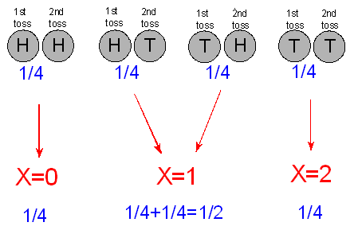
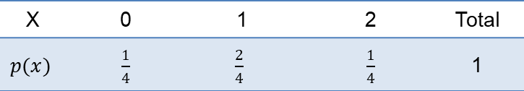
Random variable with an example
Consider an experiment where 2 fair coins are tossed. The sample space, S = {HH, HT, TH, TT}.
Let, X be the no. of tails. Then, as X takes different values 0, 1 or 2 with associated probabilities. So, X is called a random variable.
The probability distribution of the random variable X can be easily summarized in a table as:
X | 0 1 2 | Total
$$p(x)$$ | $\frac{1}{4}$ $\frac{2}{4}$ $\frac{1}{4}$ | 1
This p(x) is also a probability function.

Slide 5
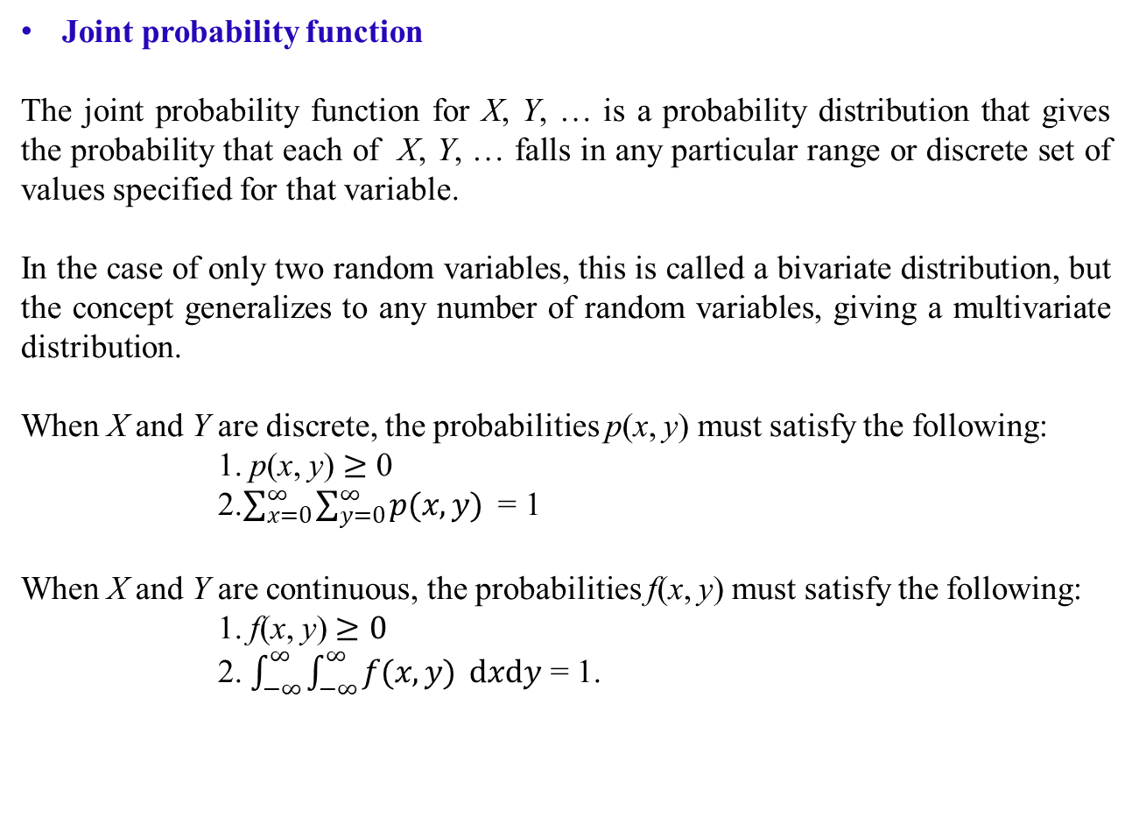
Joint probability function
The joint probability function for X, Y, … is a probability distribution that gives the probability that each of X, Y, … falls in any particular range or discrete set of values specified for that variable.
In the case of only two random variables, this is called a bivariate distribution, but the concept generalizes to any number of random variables, giving a multivariate distribution.
When X and Y are discrete, the probabilities p(x, y) must satisfy the following:
1. p(x, y) $≥$ 0
2.$\sum_{x=0}^{∞}{\sum_{y=0}^{∞}{p(x,y)} }$ = 1
When X and Y are continuous, the probabilities f(x, y) must satisfy the following:
1. f(x, y)$≥0$
2. $\int_{−∞}^{∞}{\int_{−∞}^{∞}{f(x, y) }}dxdy$ = 1.

Slide 6
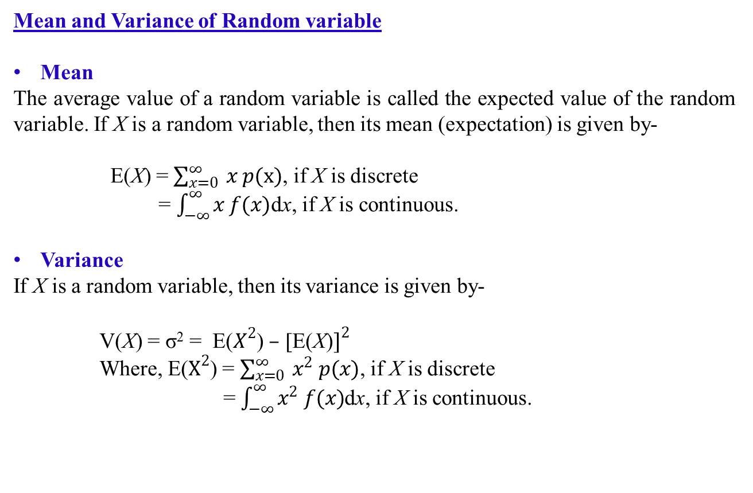
Mean and Variance of Random variable
Mean
The average value of a random variable is called the expected value of the random variable. If X is a random variable, then its mean (expectation) is given by-
E(X) = $\sum_{x=0}^{∞}{ x p(x)}$, if X is discrete
= $\int_{−∞}^{∞}{x f(x)}$dx, if X is continuous.
Variance
If X is a random variable, then its variance is given by-
V(X) = σ² = E($X^{2}$) $–$ [E(X)$]^{2}$
Where, E($X^{2}$) = $\sum_{x=0}^{∞}{ x^{2} p(x)}$, if X is discrete
= $\int_{−∞}^{∞}{x^{2} f(x)}$dx, if X is continuous.

Slide 7
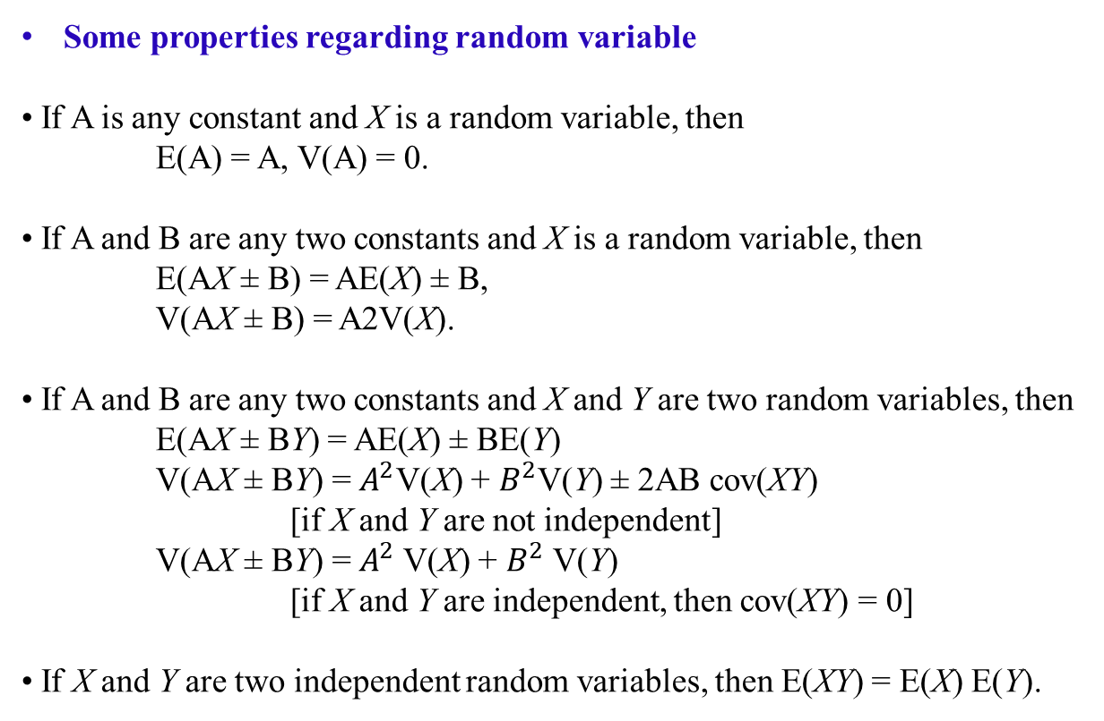
Some properties regarding random variable
If A is any constant and X is a random variable, then
E(A) = A, V(A) = 0.
If A and B are any two constants and X is a random variable, then
E(AX ± B) = AE(X) ± B,
V(AX ± B) = A2V(X).
If A and B are any two constants and X and Y are two random variables, then
E(AX ± BY) = AE(X) ± BE(Y)
V(AX ± BY) = $A^{2}$V(X) + $B^{2}$V(Y) ± 2AB cov(XY)
[if X and Y are not independent]
V(AX ± BY) = $A^{2}$V(X) + $B^{2}$V(Y)
[if X and Y are independent, then cov(XY) = 0]
If X and Y are two independent random variables, then E(XY) = E(X) E(Y).
Note: Covariance of X and Y: cov(XY) = E(XY) – E(X)E(Y)

Slide 8
Example 4.1: A random sample of graduates was surveyed at AIUB. A question that was asked is: How many times did you change majors? The results are shown in a probability distribution as:
Find the probability that a randomly selected graduate changed majors (a) more than once, (b) less or two times, and (c) four or more times.
Solution:
(a) P(X > 1) = P(X = 2) + P(X = 3) + P(X = 4) + P(X = 5)
= 0.23 + 0.09 + 0.02 + 0.01 = 0.35.
(b) P(X ≤ 2) = P(X = 0) + P(X = 1) + P(X = 2) = 0.28 + 0.37 + 0.23 = 0.88.
(c) P(X ≥ 4) = P(X = 4) + P(X = 5) = 0.02 + 0.01 = 0.03.
X | 0 | 1 | 2 | 3 | 4 | 5 | Total
P(X) | 0.28 | 0.37 | 0.23 | 0.09 | 0.02 | 0.01 | 1

Slide 9
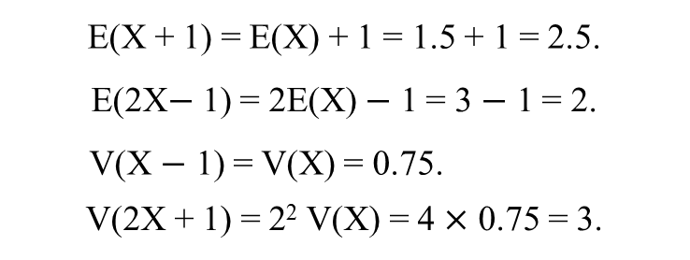
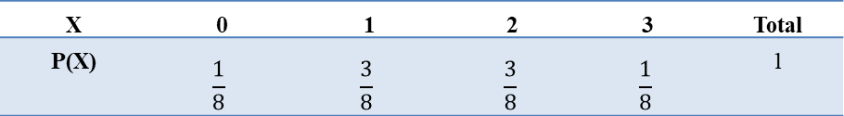
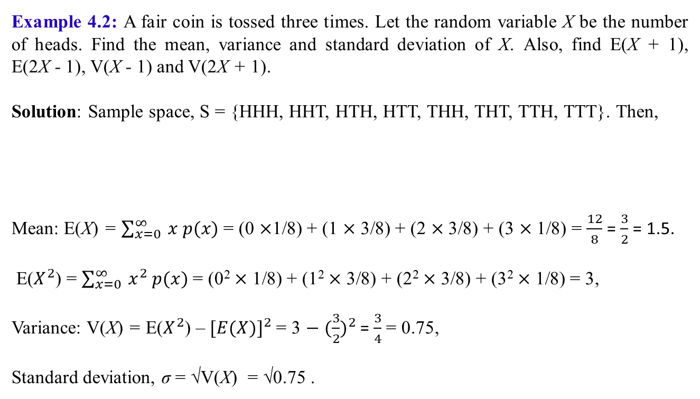
Example 4.2: A fair coin is tossed three times. Let the random variable X be the number of heads. Find the mean, variance and standard deviation of X. Also, find E(X + 1), E(2X - 1), V(X - 1) and V(2X + 1).
Solution: Sample space, S = {HHH, HHT, HTH, HTT, THH, THT, TTH, TTT}. Then,
Mean: E(X) = $\sum_{x=0}^{∞}{ x p(x)}$ = (0 $×$1/8) + (1 $×$ 3/8) + (2 $×$ 3/8) + (3 $×$ 1/8) = $\frac{12}{8}$ = $\frac{3}{2}$ = 1.5.
E($X^{2}$) = $\sum_{x=0}^{∞}{ x^{2} p(x)}$= (0² $×$ 1/8) + (1² $×$ 3/8) + (2² $×$ 3/8) + (3² $×$ 1/8) = 3,
Variance: V(X) = E($X^{2}$) – ${[E(X)]}^{2}$= 3 ${− (\frac{3}{2})}^{2}$ = $\frac{3}{4}$ = 0.75,
Standard deviation, σ = √V(X) = √0.75 .
X | 0 | 1 | 2 | 3 | Total
P(X) | $$\frac{1}{8}$$ | $$\frac{3}{8}$$ | $$\frac{3}{8}$$ | $$\frac{1}{8}$$ | 1
E(X + 1) = E(X) + 1 = 1.5 + 1 = 2.5.
E(2X$−$ 1) = 2E(X) $−$ 1 = 3 $−$ 1 = 2.
V(X $−$ 1) = V(X) = 0.75.
V(2X + 1) = 2² V(X) = 4 $×$ 0.75 = 3.

Slide 10
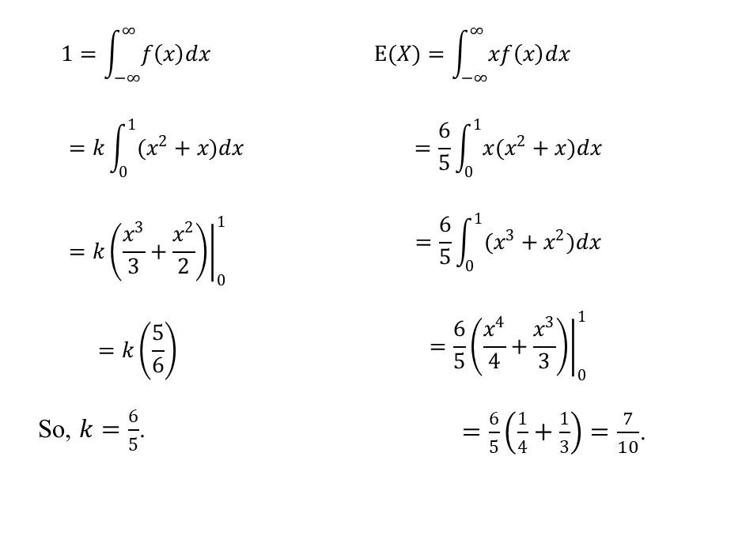
Example 4.3: The length of time X, needed by students in a Math course at AIUB, to complete a 1-hour exam is a random variable with probability density function (pdf) given by:
f(x) = k(x2+x); 0 < x < 10; otherwise
Estimate the value of k. Also, find the average time needed to complete a 1-hour exam.
Solution: A given pdf must integrate to 1. Hence,
$$1=\int_{−∞}^{∞}{f郗xdx}$$ $$=k\int_{0}^{1}{(x^{2}+x)dx}$$ $$=k{\left.\left(\frac{x^{3}}{3}+\frac{x^{2}}{2}\right)\right|}_{0}^{1}$$ $$=k\left(\frac{5}{6}\right)$$ So, $k=\frac{6}{5}$. | $$E(X)=\int_{−∞}^{∞}{xf\left(x\right)dx}$$ $$=\frac{6}{5}\int_{0}^{1}{x(x^{2}+x)dx}$$ $$=\frac{6}{5}\int_{0}^{1}{(x^{3}+x^{2})dx}$$ $$=\frac{6}{5}{\left.\left(\frac{x^{4}}{4}+\frac{x^{3}}{3}\right)\right|}_{0}^{1}$$ $=\frac{6}{5}\left(\frac{1}{4}+\frac{1}{3}\right)=\frac{7}{10}$.

Slide 11
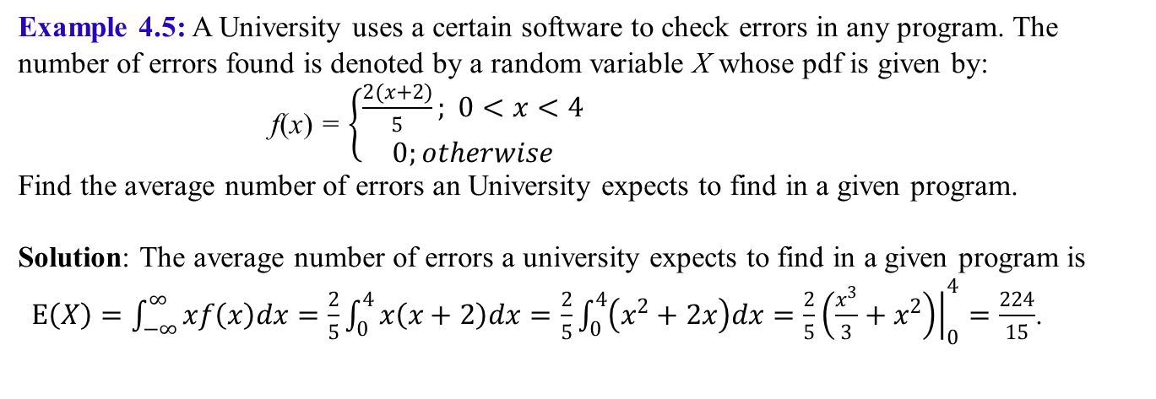
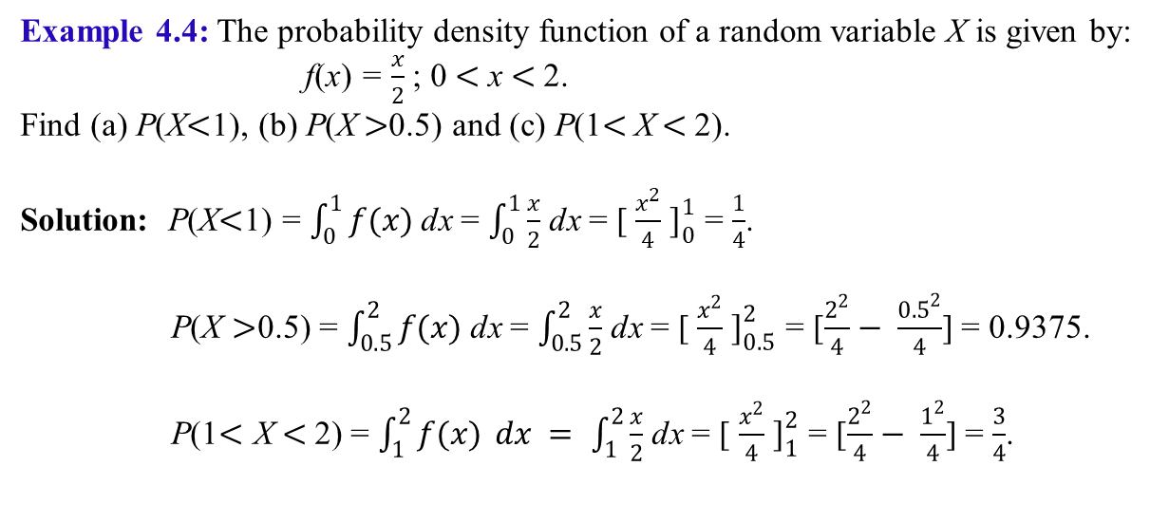
Example 4.4: The probability density function of a random variable X is given by:
f(x) = $\frac{x}{2}$ ; 0$<$ x$<$ 2.
Find (a) P(X$<$1), (b) P(X$>$0.5) and (c) P(1$<$X$<$2).
Solution: P(X$<$1) = $\int_{0}^{1}{f(x)}$ dx = $\int_{0}^{1}{\frac{x}{2}}$ dx = [ $\frac{x^{2}}{4}$ $]_{0}^{1}$ = $\frac{1}{4}$.
P(X $>$0.5) = $\int_{0.5}^{2}{f(x)}$ dx = $\int_{0.5}^{2}{\frac{x}{2}}$ dx = [ $\frac{x^{2}}{4}$ $]_{0.5}^{2}$ = [$\frac{2^{2}}{4}− \frac{{0.5}^{2}}{4}$] = 0.9375.
P(1$<$ X $<$2) = $\int_{1}^{2}{f(x)} dx = \int_{1}^{2}{\frac{x}{2}}$ dx = [ $\frac{x^{2}}{4}$ $]_{1}^{2}$ = [$\frac{2^{2}}{4}− \frac{1^{2}}{4}$] = $\frac{3}{4}$.
Example 4.5: A University uses a certain software to check errors in any program. The number of errors found is denoted by a random variable X whose pdf is given by:
f(x) = $\left\{\begin{aligned}\frac{2(x+2)}{5}; 0<x<4 \\ 0;otherwise\end{aligned}\right.$
Find the average number of errors an University expects to find in a given program.
Solution: The average number of errors a university expects to find in a given program is
$E\left(X\right)=\int_{−∞}^{∞}{xf\left(x\right)dx}=\frac{2}{5}\int_{0}^{4}{x\left(x+2\right)dx}=\frac{2}{5}\int_{0}^{4}{\left(x^{2}+2x\right)dx}=\frac{2}{5}{\left.\left(\frac{x^{3}}{3}+x^{2}\right)\right|}_{0}^{4}=\frac{224}{15}$.

Slide 12
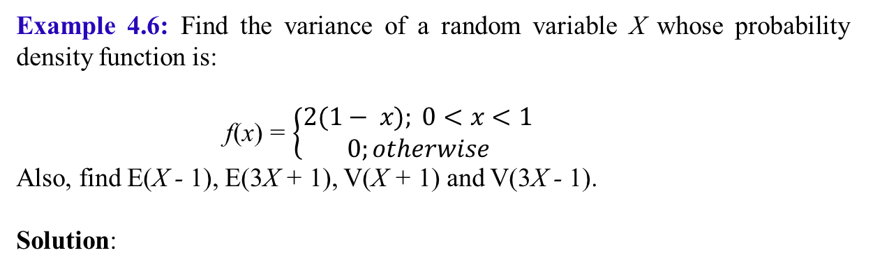
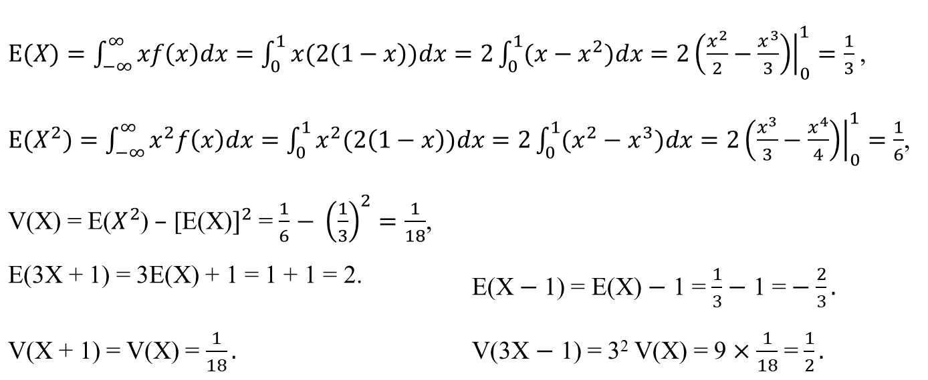
Example 4.6: Find the variance of a random variable X whose probability density function is:
f(x) = $\left\{\begin{aligned}2(1− x); 0<x<1 \\ 0;otherwise\end{aligned}\right.$
Also, find E(X - 1), E(3X + 1), V(X + 1) and V(3X - 1).
Solution:
$E(X)=\int_{−∞}^{∞}{xf\left(x\right)dx}=\int_{0}^{1}{x(2\left(1−x\right))dx}=2\int_{0}^{1}{(x−x^{2})dx}=2{\left.\left(\frac{x^{2}}{2}−\frac{x^{3}}{3}\right)\right|}_{0}^{1}=\frac{1}{3}$,
$E(X^{2})=\int_{−∞}^{∞}{x^{2}f\left(x\right)dx}=\int_{0}^{1}{x^{2}(2\left(1−x\right))dx}=2\int_{0}^{1}{(x^{2}−x^{3})dx}=2{\left.\left(\frac{x^{3}}{3}−\frac{x^{4}}{4}\right)\right|}_{0}^{1}=\frac{1}{6}$, V(X) = E($X^{2}$) $–$ [E(X)$]^{2}$ = $\frac{1}{6}$ $− {\left(\frac{1}{3}\right)}^{2}=\frac{1}{18}$,
E(3X + 1) = 3E(X) + 1 = 1 + 1 = 2. | E(X$−$ 1) = E(X) $−$ 1 = $\frac{1}{3}−$ 1 =$−$ $\frac{2}{3}.$
V(X + 1) = V(X) = $\frac{1}{18}.$ | V(3X $−$ 1) = 3² V(X) = 9 $×\frac{1}{18}$ = $\frac{1}{2}.$

Slide 13
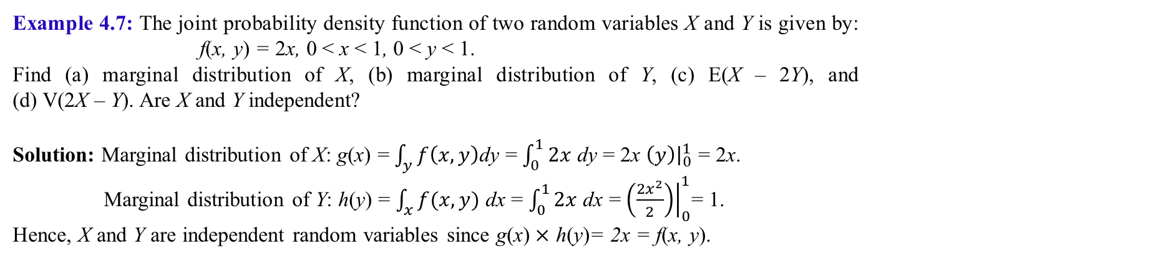
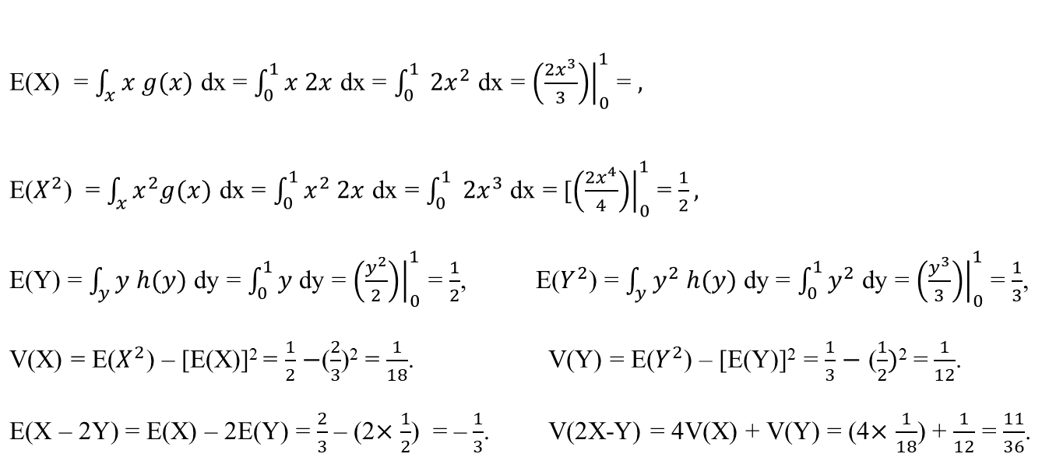
Example 4.7: The joint probability density function of two random variables X and Y is given by: f(x, y) = 2x, 0 < x < 1, 0 < y < 1.
Find (a) marginal distribution of X, (b) marginal distribution of Y, (c) E(X – 2Y), and (d) V(2X – Y). Are X and Y independent?
Solution: Marginal distribution of X: g(x) = $\int_{y}{f\left(x,y\right)}$dy = $\int_{0}^{1}{2x}$ dy = 2x ${\left.\left(y\right)\right|}_{0}^{1}$ = 2x.
Marginal distribution of Y: h(y) = $\int_{x}{f(x,y)}$ dx = $\int_{0}^{1}{2x}$ dx = ${\left.\left(\frac{{2x}^{2}}{2}\right)\right|}_{0}^{1}$= 1.
Hence, X and Y are independent random variables since g(x)$×$ h(y)= 2x = f(x, y).
E(X) = $\int_{x}{x g(x)}$ dx = $\int_{0}^{1}{x 2x}$ dx = $\int_{0}^{1}{ {2x}^{2}}$ dx = ${\left.\left(\frac{{2x}^{3}}{3}\right)\right|}_{0}^{1}$ = $,$
E($X^{2}$) = $\int_{x}{x^{2}g(x)}$ dx = $\int_{0}^{1}{x^{2} 2x}$ dx = $\int_{0}^{1}{ {2x}^{3}}$ dx = [${\left.\left(\frac{{2x}^{4}}{4}\right)\right|}_{0}^{1}$ = $\frac{1}{2},$
E(Y) = $\int_{y}{y h(y)}$ dy = $\int_{0}^{1}{y}$ dy = ${\left.\left(\frac{y^{2}}{2}\right)\right|}_{0}^{1}$ = $\frac{1}{2}$, | E($Y^{2}$) = $\int_{y}{y^{2} h(y)}$ dy = $\int_{0}^{1}{y^{2}}$ dy = ${\left.\left(\frac{y^{3}}{3}\right)\right|}_{0}^{1}$ = $\frac{1}{3}$,
V(X) = E($X^{2}$) – [E(X)]² = $\frac{1}{2}$ $−$($\frac{2}{3}$)² = $\frac{1}{18}$. | V(Y) = E($Y^{2}$) – [E(Y)]² = $\frac{1}{3}$ $−$ ($\frac{1}{2})$² =$\frac{1}{12}$.
E(X – 2Y) = E(X) – 2E(Y) = $\frac{2}{3}$ – (2$×$ $\frac{1}{2}$) = –$\frac{1}{3}$. | V(2X-Y) = 4V(X) + V(Y) = (4$×$ $\frac{1}{18}$) + $\frac{1}{12}$ = $\frac{11}{36}$.

Slide 14
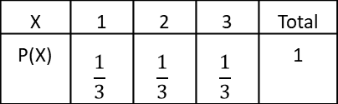
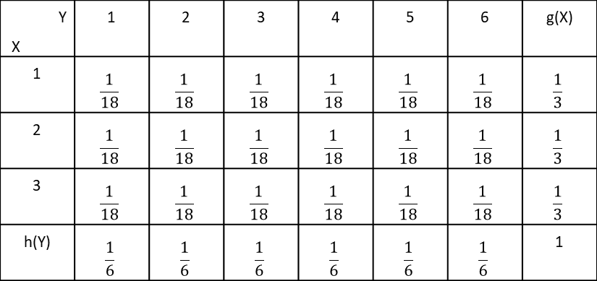

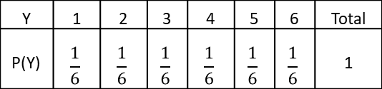
Example 4.8: The joint probability function of two random variables X and Y is given as:
Find (a) marginal distribution of X, (b) marginal distribution of Y, (c) E(X) and (d) E(Y).
Solution: Marginal distribution of X:
E(X) = $\sum_{x=0}^{∞}{ x p(x)}$ = (1 $×$ $\frac{1}{3}$) + (2 $×$ $\frac{1}{3}$) + (3 $×$ $\frac{1}{3}$) = 2.
Marginal distribution of Y:
E(Y) = $\sum_{y=0}^{∞}{ y p(y)}$ = (1 $×$ $\frac{1}{6}$) + (2 $×$ $\frac{1}{6}$) + (3 $×$ $\frac{1}{6}$) + (4 $×$ $\frac{1}{6}$) + (5 $×$ $\frac{1}{6}$) + (6 $×$ $\frac{1}{6}$) = $\frac{21}{6}$.
Y X | 1 | 2 | 3 | 4 | 5 | 6 | g(X)
1 | $$\frac{1}{18}$$ | $$\frac{1}{18}$$ | $$\frac{1}{18}$$ | $$\frac{1}{18}$$ | $$\frac{1}{18}$$ | $$\frac{1}{18}$$ | $$\frac{1}{3}$$
2 | $$\frac{1}{18}$$ | $$\frac{1}{18}$$ | $$\frac{1}{18}$$ | $$\frac{1}{18}$$ | $$\frac{1}{18}$$ | $$\frac{1}{18}$$ | $$\frac{1}{3}$$
3 | $$\frac{1}{18}$$ | $$\frac{1}{18}$$ | $$\frac{1}{18}$$ | $$\frac{1}{18}$$ | $$\frac{1}{18}$$ | $$\frac{1}{18}$$ | $$\frac{1}{3}$$
h(Y) | $$\frac{1}{6}$$ | $$\frac{1}{6}$$ | $$\frac{1}{6}$$ | $$\frac{1}{6}$$ | $$\frac{1}{6}$$ | $$\frac{1}{6}$$ | 1
X | 1 | 2 | 3 | Total
P(X) | $$\frac{1}{3}$$ | $$\frac{1}{3}$$ | $$\frac{1}{3}$$ | 1
Y | 1 | 2 | 3 | 4 | 5 | 6 | Total
P(Y) | $$\frac{1}{6}$$ | $$\frac{1}{6}$$ | $$\frac{1}{6}$$ | $$\frac{1}{6}$$ | $$\frac{1}{6}$$ | $$\frac{1}{6}$$ | 1

Slide 15
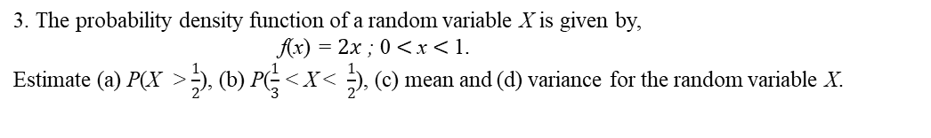
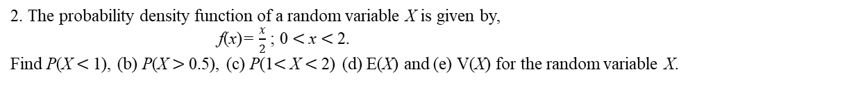
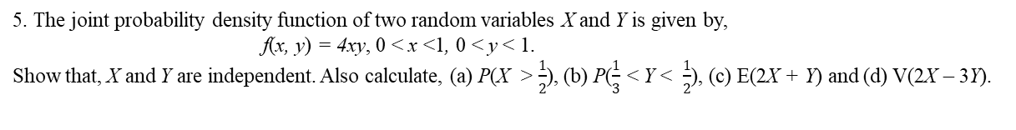
Exercise 4
A random sample of graduates was surveyed at AIUB. A question that was asked is: How many times did you change majors? The results are shown in a probability distribution as:
Find the probability that a randomly selected graduate changed majors (a) more than once, (b) two or less times, and (c) two or more times. Also estimate (d) E(2X + 1) and (e) V(4X - 3) mean, and (e) variance for the random variable X.
X | 0 | 1 | 2 | 3 | Total
P(X) | 0.20 | 0.30 | 0.20 | 0.30 | 1
2. The probability density function of a random variable X is given by,
f(x)= $\frac{x}{2}$ ; 0$<$x$<$2.
Find P(X$<$1), (b) P(X$>$0.5), (c) P(1$<$X$<$2) (d) E(X) and (e) V(X) for the random variable X.
3. The probability density function of a random variable X is given by,
f(x) = $2x$ ; 0$<$x$<$1.
Estimate (a) P(X > $\frac{1}{2}$), (b) P($\frac{1}{3}$ < X < $\frac{1}{2}$), (c) mean and (d) variance for the random variable X.
4. The joint probability density function of two random variables X and Y is given by:
f(x, y) = 4x(1 – y), 0 < x < 1, 0 < y < 1.
Show that, X and Y are independent random variables.
5. The joint probability density function of two random variables X and Y is given by,
f(x, y) = 4xy, 0 < x <1, 0 < y < 1.
Show that, X and Y are independent. Also calculate, (a) P(X > $\frac{1}{2}$), (b) P($\frac{1}{3}$ < Y < $\frac{1}{2}$), (c) E(2X + Y) and (d) V(2X – 3Y).
6. The joint probability function of two random variables X and Y is given as:
Find (a) marginal distribution of X, (b) marginal distribution of Y, (c) E(5X–Y) and (d) V(Y–2X).
Y X | 0 | 1 | 2
0 | 0.10 | 0.20 | 0.00
1 | 0.10 | 0.20 | 0.10
2 | 0.00 | 0.10 | 0.10
3 | 0.10 | 0.00 | 0.00

Slide 16
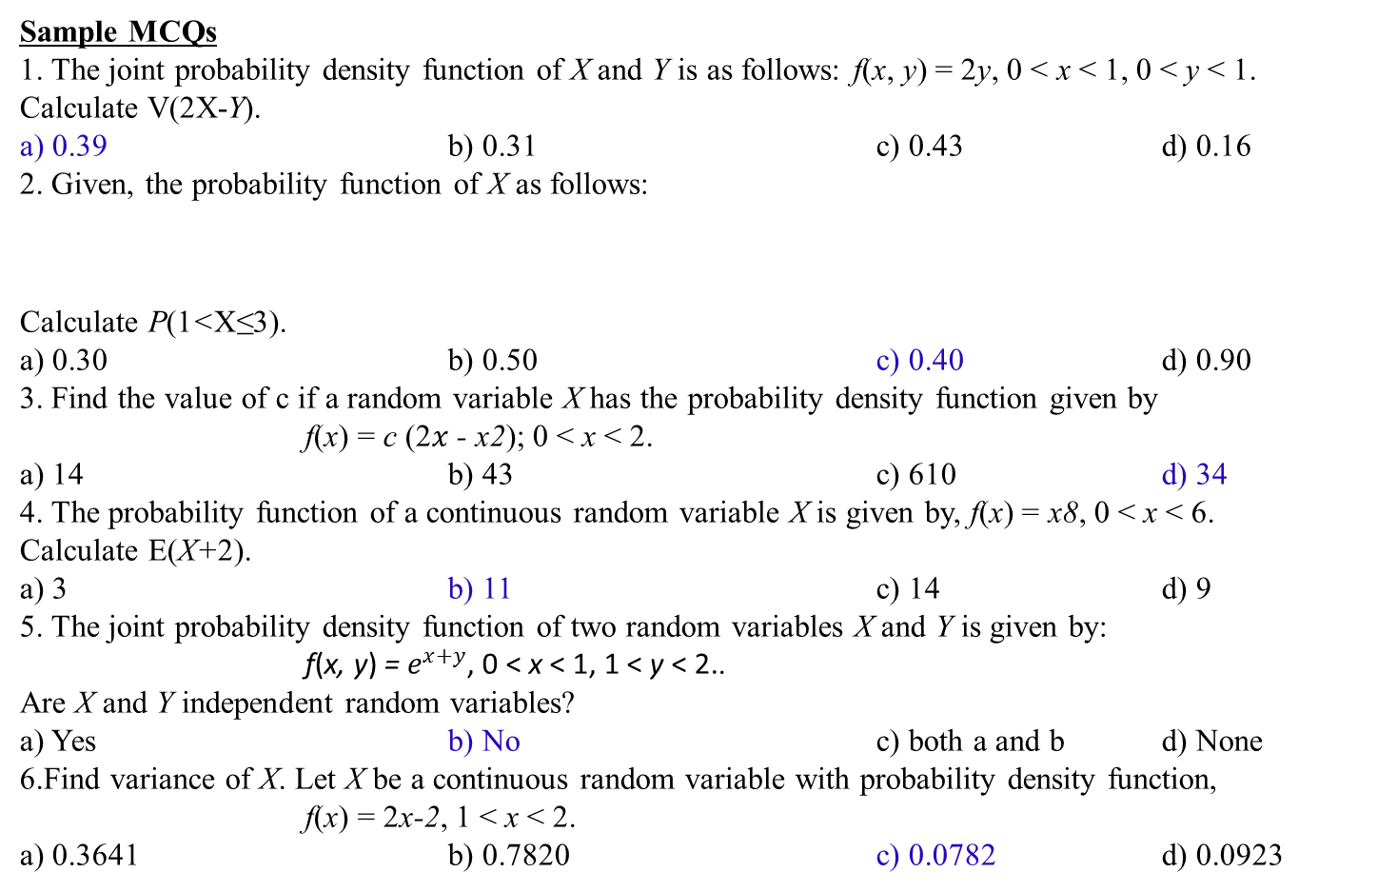
Sample MCQs
1. The joint probability density function of X and Y is as follows: f(x, y) = 2y, 0 < x < 1, 0 < y < 1. Calculate V(2X-Y).
a) 0.39 b) 0.31 c) 0.43 d) 0.16
2. Given, the probability function of X as follows:
Calculate P(1<X≤3).
a) 0.30 b) 0.50 c) 0.40 d) 0.90
3. Find the value of c if a random variable X has the probability density function given by
f(x) = c (2𝑥 - x2); 0 < x < 2.
a) 14 b) 43 c) 610 d) 34
4. The probability function of a continuous random variable X is given by, f(x) = x8, 0 < x < 6.
Calculate E(X+2).
a) 3 b) 11 c) 14 d) 9
5. The joint probability density function of two random variables X and Y is given by:
f(x, y) = $e^{x+y}$, 0 < x < 1, 1 < y < 2..
Are X and Y independent random variables?
a) Yes b) No c) both a and b d) None
6.Find variance of X. Let X be a continuous random variable with probability density function,
f(x) = 2x-2, 1 < x < 2.
a) 0.3641 b) 0.7820 c) 0.0782 d) 0.0923
X | 0 1 2 3
P(X) | 0.4 0.2 0.1 0.3

